Slide 1
Lecture 0 Introduction to Machine Learning Fall Semester 2020-2021 ⇨ Syllabus—Homeworks—Exam
András Lőrincz
Department of Artificial Intelligence
Faculty of Informatics

Slide 2
Three courses in one lecture (this year)
BSc course for
Hungarian student of the Faculty of Informatics (2 credits)
English students of the Faculty of Informatics (3 credits)
MSc course for
Students of the Faculty of Education and Psychology (4 credits)
Basic knowledge of
probability theory,
linear algebra,
calculus
are required. Everybody is supposed to know these topics already. However, there are considerable differences that call for homeworks / excercises, mandatory for „Type 2” and „Type 3” students.

Slide 3
Homeworks / exercises
Lectures are on Wednesdays, between 4.00PM and 5.00PM
Due to Covid and to the large number of students who registered for the course, I am preparing videos for each lecture, since streaming may frequently fail and you could be lost in the lecture.
To each lecture there is a list of problems/questions. It is at the end of the talk. The starting slide of the list is titled: „what we learned today”. You have to submit your answers one day before the next talk.
I am not going to check if you are present at the talk or not. That, however, justifies the rigor concerning the homeworks and the questions and their precise, timely submission.
„Type 2” and „Type 3” students: You are supposed to do the homeworks and to submit them the day before the next lecture. Not all lectures have homeworks. But, if they do, then you need to submit the solutions one day before the next lecture.
Justification: Homeworks help your understanding of the coming lecture.
Consulting on the homeworks is possible.
Consulting teacher: Zoltán Milacski.
Consulting time: Tuesdays 7.00PM-8.00PM
Consulting is online. Questions are to be submitted on Mondays before 7.00PM.
Concerning the „questions”: all students are supposed to submit those before the next lecture.

Slide 4
Submit your answers / solutions according to the instructions in section „assignments” in CANVAS

Slide 5
Exam
Exams are the same for all three courses!
Note for „2” an „3” type students:
We will try to exclude those from the exam who copied the answers of the homeworks/exercises
Examination starts with a written exam with
questions from the homeworks – in turn, „Type 1” students may wish to do the homeworks, too...
questions from the lists on „what we learned today”
It is our goal to discourage communication – a hard task for us, since the exam is online. This is our plan:
You may need to perform short computations with a single number to be submitted
You will have quizzes to be filled in
Short computations (if any) and quizzes will be randomly selected for all students and will be sent to you individually at the same time.
Response time will be limited
It will be hard to finish the quizzes in time – an additional constraint that I have to exploit – and we will use statistical means to grade you.
See an additional constraint below concerning the homeworks and questions to be unswered during the year.
I am sorry about the uncertainties here (i.e., that definite levels can not be given to you). I am open to any suggestion that takes of the burden of 300 individual examinees
Grading:
Have you submitted your homeworks and answers to the questions in time? It is important to submit your answers as detailed before. Nonetheless, you may miss uploading 3 responses and you can still enter the written exam. Grading levels for the written exam will be given at the time of the exam – but see points 1&2 above.
Academic dishonesty (quoted from Dana Ballard’s course): Students caught plagiarizing will fail the course. On some projects, we will use software to analyze code similarity. Avoid plagiarism when coding and when answering the questions by carefully citing all your sources. If you use a specific short code snippet found on a web-page, mention that fact in a comment. If someone else told you how to solve a tricky part of an assignment, give them credit, too. Do not copy code from other students. However, if you did and cited them for it, I suppose that you would not fail for plagiarism; you simply would not get credit for the assignment. Even so, don't do it.

Slide 6
CONTENT
Old New
1. Introduction
2. IQ and making sense
3. Key problems of AI and HI
4. Goal oriented systems
5. Classical AI, learning from examples, combination
6. Image processing
7. Speech processing
8. Video and natural language processing
9. Embedding and visualizations for human understanding
10. Human-machine interaction
11. Distributed intelligence
12. Summary: Artificial General Intelligence
1. Introduction
2. Cognition, IQ and making sense
3. Key problems of AI and human intelligence
4. Goal oriented systems
5. Classical AI versus learning from examples: how to combine them?
6. Image and video processing
Mid-term exam (October 21, 2020)
7. Speech processing, natural language processing
8. Behavior characterization and situation understanding
9. Explainability (XAI) for human understanding, information fusion and distributed intelligence
10. Human-machine interaction, „Edge TPUs”, and distributed intelligence
11. Control, influencing, fake information, legal and ethical issues,
12. Summary: Artificial General Intelligence
➔ Final exam

Slide 7
Mathematical Tour on Linear Algebra and related homeworks and Questions about „what we have learned” TASKS for the 1st week

Slide 8
Only Homework (no „Questions”)
Deadline: before the next talk – as usual.
Limit is milder on Canvas, but points are subtracted according to the late policy.
If the homeworks are hard for you and/or take too much of your time, then drop the course! You need to study more before entering the course.
In case if you need a very basic intro with useful geometric interpretations, then listen to this youtube video:
https://www.youtube.com/watch?v=kZwSqZuBMGg
Homework is from a 17 (21 with cover page + table of content etc.) page, mild introductory book. Answer the „Your Task” subsection at the end of each of the 7 Lessons. To do so, click on the link of
Jason Brownlee:
https://machinelearningmastery.com/linear_algebra_for_machine_learning/
Submit your answers to Assignments in CANVAS
Use the appropriate week

Slide 9
Mathematical Tour on Probability Theory and related homeworks and Questions about „what we have learned” TASKS for the 2nd week

Slide 10
Mathematical Tour and Homeworks

Slide 11



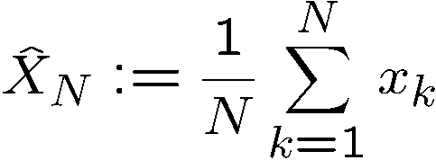
Mathematical tour Law of large numbers
X stochastic variable,
has finite expected value,
has finite standard deviation,
we take N independent samples from X:
x₁, x₂, …, x_{N}
x_{k}’s are independent
average:

Slide 12

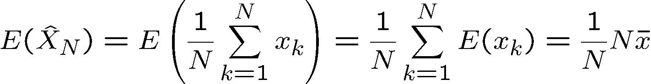
Mathematical tour Law of large numbers
Proof: trivial

Slide 13

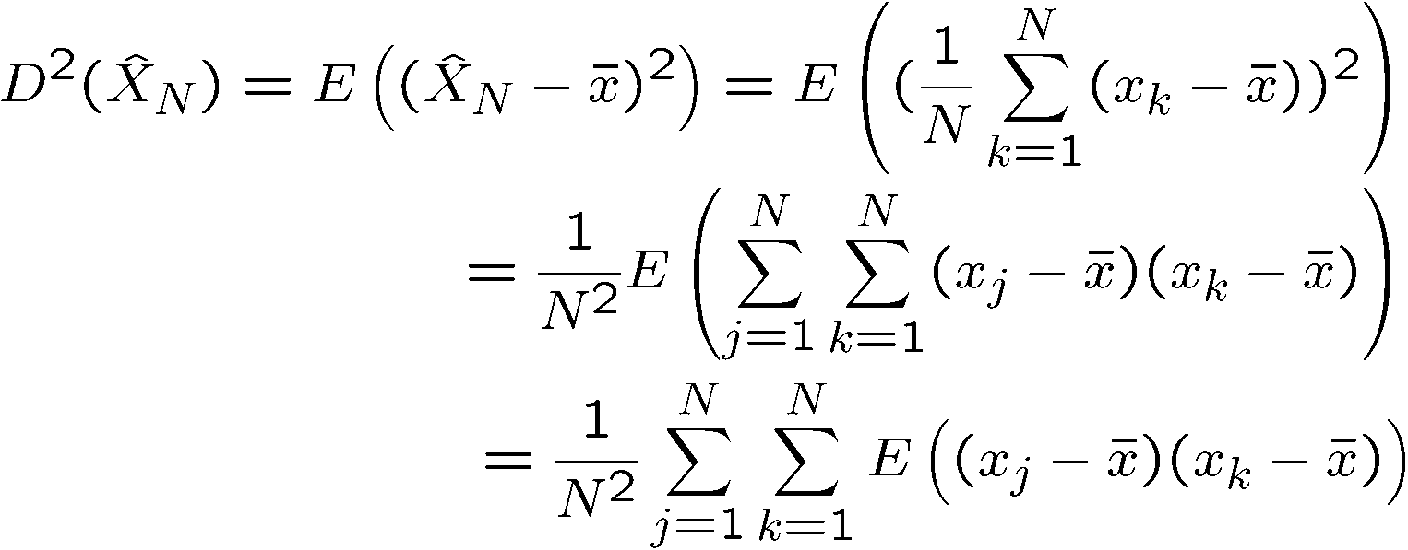

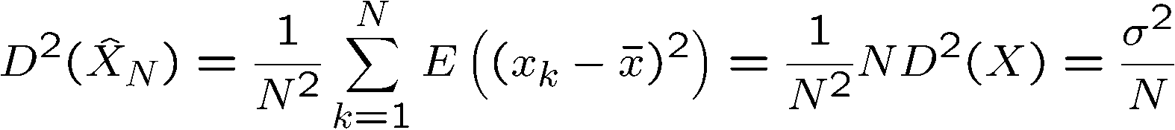
Mathematical tour Law of large numbers
Theorem:
Proof:
if i≠j, then due to independece:
and thus:

Slide 14
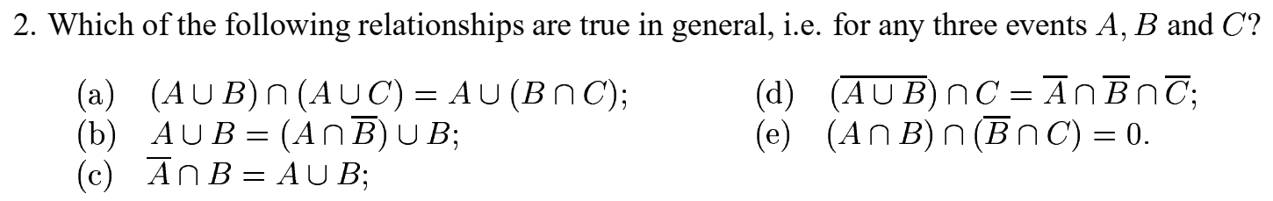
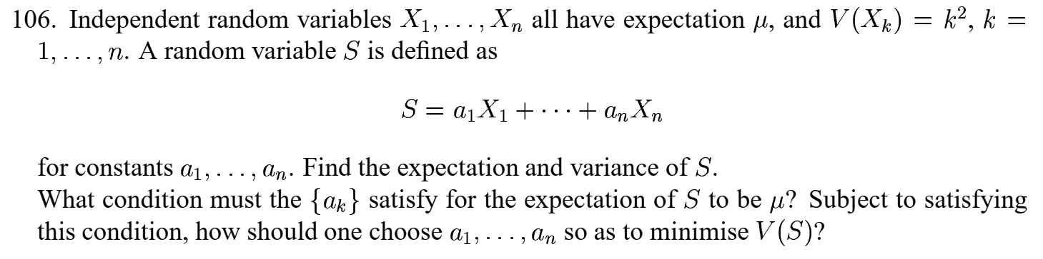
Homeworks from Martin Ridout 107 Exercises in Probability Theory University of Kent

Slide 15
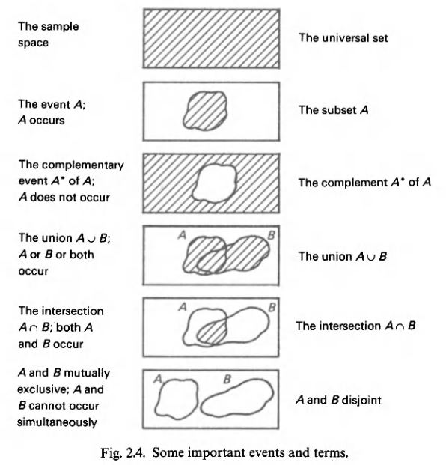
Probability and Statistics Harald Lang Gunnar Blom Notations

Slide 16
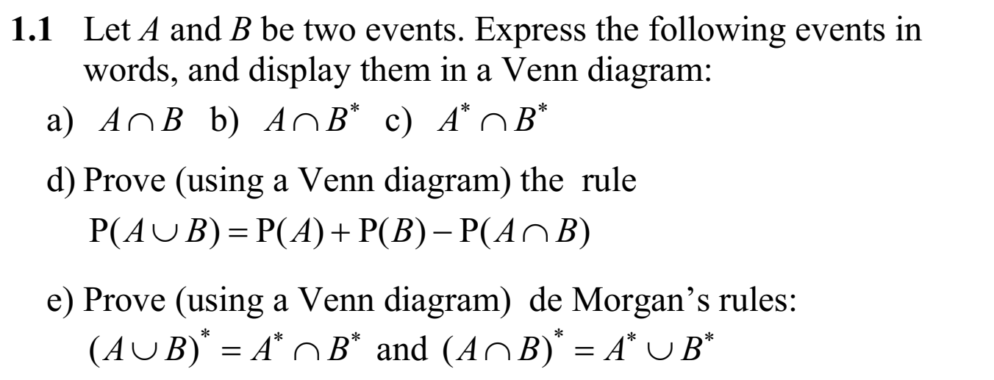
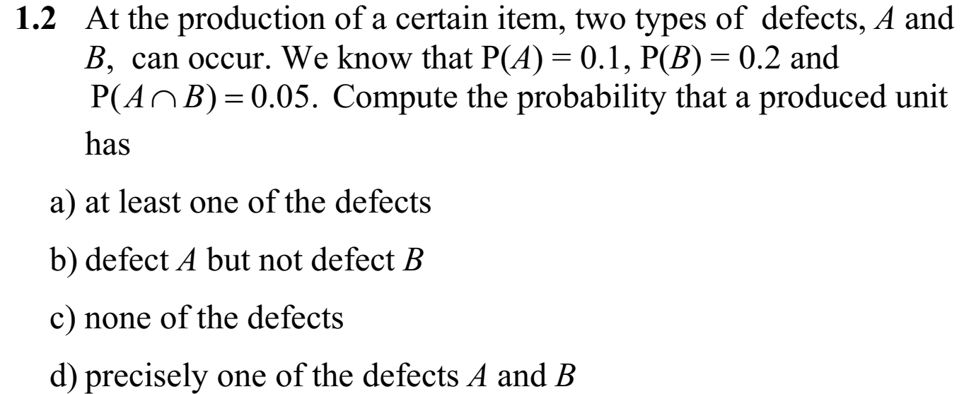
Probability and Statistics Harald Lang Gunnar Blom

Slide 17
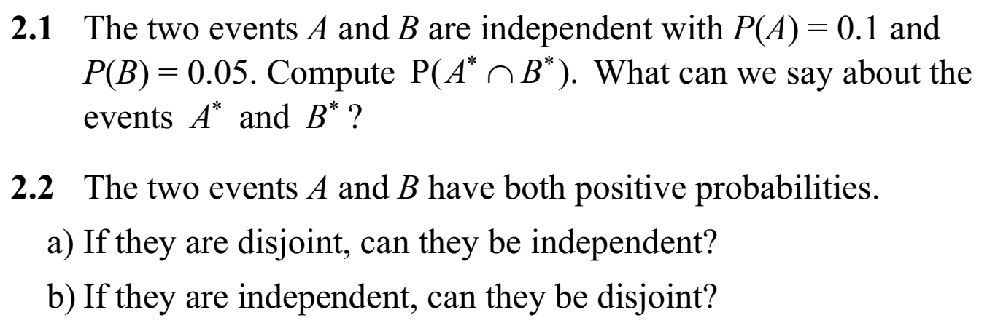
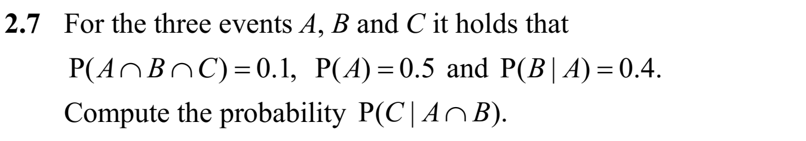
Probability and Statistics Harald Lang Gunnar Blom

Slide 18
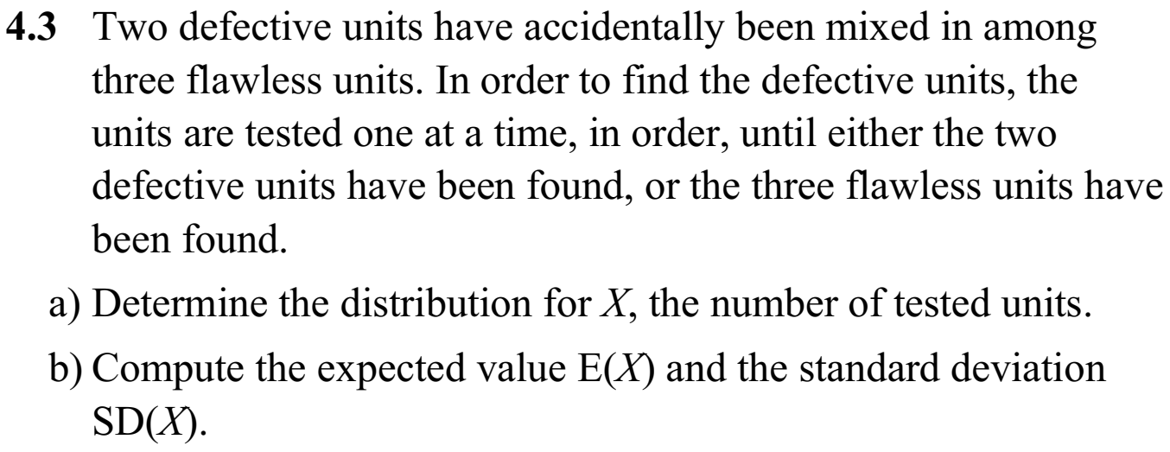
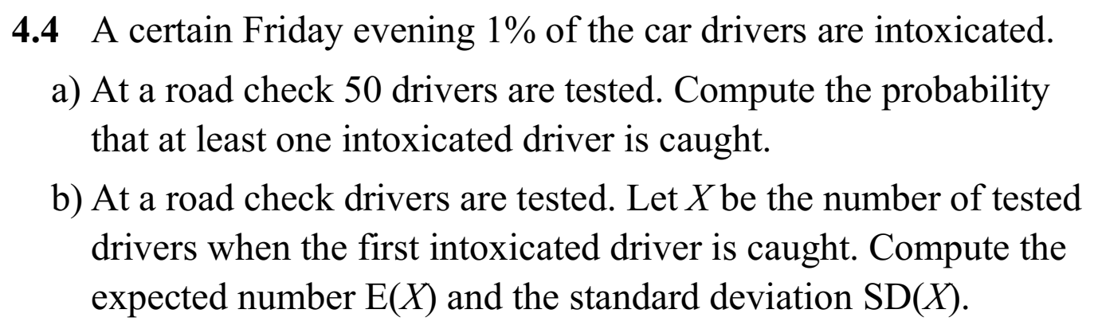
Probability and Statistics Harald Lang Gunnar Blom KTH

Slide 19
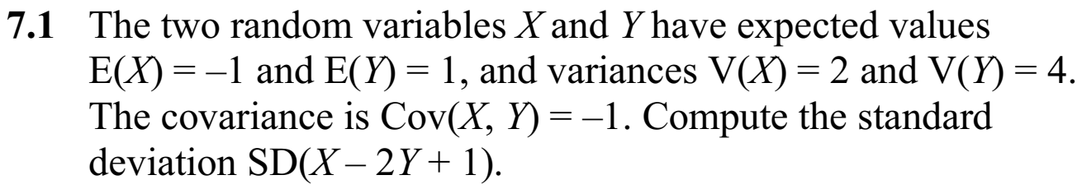
Probability and Statistics Harald Lang Gunnar Blom KTH

Slide 20
Questions about „What we learned today”

Slide 21
Questions about „What we learned today”
What is the expected value of a random/stochastic variable?
What is the probability distribution of a discrete stochastic variable?
What is the average value of the result when a stochastic variable is sampled N times?
What is the definition of standard deviation?
What is the relation between the standard deviation and the expected value of a discrete stochastic variable?
What does the „Law of large numbers” claim? State it!
What does the „Law of large numbers” claim? Prove it!

Slide 22
More literature for the course

Slide 23
More literature for the course
Introductory books to linear algebra and on probabilty theory – They may be of help to you
https://drive.google.com/file/d/1Oax0glSVJl8tUhv92L6GtXxP1vwwfcuW/view?usp=sharing
https://drive.google.com/file/d/1ur3DG-00orKvdH_kI9ixw__1vSlU70fZ/view?usp=sharing
https://drive.google.com/file/d/1JBKM8XQgpk1IIjmAUj5mwwF21IF0whoF/view?usp=sharing
https://drive.google.com/file/d/14b9PTlseUdy_8xjyLQmi8M0mTM744U7G/view?usp=sharing (in Hungarian)
https://drive.google.com/file/d/1xol_u_AyRapyQ4hA3mDCxdmPqlVD0O-y/view?usp=sharing (in Hungarian)
https://drive.google.com/file/d/1Cpci_22k0d3VRYVfUSzY9vlvXfCy_9NI/view?usp=sharing (in Hungarian)
Very good – but hard – books for AI an around AI – for those who want to dig deeper
https://drive.google.com/file/d/11CVxmPXHApPL7zP7IsiraK9iNqDgH-ww/view?usp=sharing
https://drive.google.com/file/d/1gUUHphH9EvOqo5jwff27Mm8LFp4fxchB/view?usp=sharing
Software related
https://drive.google.com/file/d/1bGwper1wzF7scFh9gwFgTlHfiNhWF5PB/view?usp=sharing

Slide 24
This
is the
END!
lorincz@inf.elte.hu

